Slide 2
Operating SYSTEMS aND Systems Programming (CT30A3370) 6 credits
January 17, 2023
Venkata Marella

Slide 3
Chapter 4: Threads
Overview
Multithreading Models
Threading Issues
Pthreads
Windows XP Threads
Linux Threads
Java Threads
Notes:
A thread is a basic unit of CPU utilization; it comprises a thread ID, a program counter, a register set, and a stack.
A traditional (or heavyweight) process has a single thread of control.
If a process has multiple threads of control, it can perform more than one task at a time.

Slide 4
Suppose you are developing a Web browser
Main(){
While(1){
RetrieveData(); DisplayData(); GetInputEvents();
}
}
// Block for 1 second
// Block for 1 second
// Block for 1 second
Now what if you want the program to be more responsive?
Main(){
While(1){
RetrieveALittleData(); DisplayALittleData(); GetAFewInputEvents();
// Block for 0.1 second
// Block for 0.1 second
// Block for 0.1 second
}
}
Silberschatz, Galvin Operating System Concepts – 7th Edition and Gagne ©2005

Slide 5
What if you want it to be even more responsive?
Main(){
While(1){
if(CheckData()==True){
RetrieveALittleData(); DisplayALittleData();
}
if(CheckInputEvents()==True){ GetAFewInputEvents();
}
}
}
// 0.1 second
// 0.1 second
// 0.1 second
Problem: A lot Checks, not efficient. And still not responsive!
Silberschatz, Galvin Operating System Concepts – 7th Edition and Gagne ©2005

Slide 6
To make it responsive enough, we need to
Break the operations into very very small pieces;
However, to be efficient enough, we want to execute large pieces.
More precisely, we want to SCHEDULE these operations in our own program code.
Leave the tedious work to the OS which schedules them in Threads!
Silberschatz, Galvin Operating System Concepts – 7th Edition and Gagne ©2005

Slide 7
Multi-thread version of the program
Main(){
CreateThread (RetrieveData()); CreateThread (DisplayData()); CreateThread (GetInputEvents()); WaitForThreads();
}
// Each thread routine enters a loop.
Void RetrieveData(){ while(1){
retrieveData();
…
}
}
….
……
Void DisplayData(){ while(1){
displayData();
…
}
}
Silberschatz, Galvin Operating System Concepts – 7th Edition and Gagne ©2005
Notes:
A web browser might have one thread display images or text while another thread retrieves data from the network, for example.
A word processor may have a thread for displaying graphics, another thread for responding to keystrokes from the user, and a third thread for performing
spelling and grammar checking in the background.
A web server accepts client requests for web pages, images, sound, and so forth.
A busy web server may have several (perhaps thousands of) clients concurrently accessing it.

Slide 8
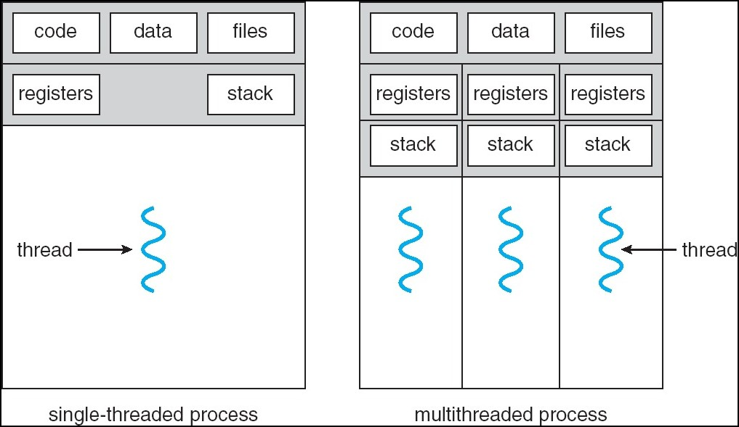
Single and Multithreaded Processes
Silberschatz, Galvin Operating System Concepts – 7th Edition and Gagne ©2005
Notes:
A thread is a basic unit of CPU utilization; it comprises a thread ID, a program counter, a register set, and a stack.
Multithreaded programming provides a mechanism for more efficient use of these multiple computing cores and improved concurrency.
Parallelism- A system is parallel if it can perform more than one task simultaneously.
Data parallelism focuses on distributing subsets of the same data across multiple computing cores and performing the same operation on each
core.
Task parallelism involves distributing not data but tasks (threads) across multiple computing cores.
Concurrency- a concurrent system supports more than one task by allowing all the tasks to make progress
A single processor system would create and illusion of parallelism. CPU schedulers were designed to provide the illusion of parallelism by rapidly switching between processes in the system.

Slide 9
Benefits
Responsiveness
interactive applications
Resource Sharing
memory for code and data can be shared.
Economy
creating processes are more expensive.
Utilization of MP Architectures
multi-threading increases concurrency.
Silberschatz, Galvin Operating System Concepts – 7th Edition and Gagne ©2005
Notes:
Allocating memory and resources for process creation is costly.
Because threads share the resources of the process to which they belong,
it is more economical to create and context-switch threads.

Slide 10
Thread Vs Process
processes are typically independent, while threads exist as subsets of a process
processes carry considerably more state information than threads, whereas multiple threads within a process share process state as well as memory and other resources
processes have separate address spaces, whereas threads share their address space
processes interact only through system-provided inter-process communication mechanisms
context switching between threads in the same process is typically faster than context switching between processes.
Silberschatz, Galvin Operating System Concepts – 7th Edition and Gagne ©2005
Notes:
User threads are supported above the kernel and are managed without kernel support, whereas kernel threads are supported and managed directly by the operating system.
Support for threads may be provided either at the user level, for user threads, or by the kernel, for kernel threads.

Slide 11
User Threads
Thread management done by user-level threads library
Three primary thread libraries:
POSIX Pthreads (can also be provided as system library)
Win32 threads
Java threads
Silberschatz, Galvin Operating System Concepts – 7th Edition and Gagne ©2005
Notes:
A thread library provides the programmer with an API for creating and managing threads.
There are two primary ways of implementing a thread library.
The first approach is to provide a library entirely in user space with no
kernel support. All code and data structures for the library exist in user space. This means that invoking a function in the library results in a local function call in user space and not a system call.
The second approach is to implement a kernel-level library supported directly by the operating system. In this case, code and data structures for
the library exist in kernel space. Invoking a function in the API for the library typically results in a system call to the kernel.
Three main thread libraries are in use today: POSIX Pthreads,Windows, and Java.
Pthreads, the threads extension of the POSIX standard, may be provided as either a user-level or a kernel-level library.
The Windows thread library is a kernel-level library available on Windows systems.
The Java thread API allows threads to be created and managed directly in Java programs.

Slide 12
Kernel Threads
Supported by the Kernel
Almost all contemporary OS implements kernel threads. Examples
Windows XP/2000
Solaris
Linux
Tru64 UNIX
Mac OS X
Silberschatz, Galvin Operating System Concepts – 7th Edition and Gagne ©2005
Notes:
threads may be provided either at the user level, for user threads, or by the kernel, for kernel threads.
User threads are supported above the kernel and are managed without kernel support,
whereas kernel threads are supported and managed directly by the operating system.
a relationship must exist between user threads and kernel threads.
In this section, we look at three common ways of establishing such a relationship: the many-to-one model, the one-to-one model, and the many-to many
model.

Slide 13
Multithreading Models
Many-to-One
thread mgmt is efficient, but will block if making system call, kernel can schedule only one thread at a time
One-to-One
more concurrency, but creating thread is expensive
Many-to-Many flexible
Silberschatz, Galvin Operating System Concepts – 7th Edition and Gagne ©2005
Notes:
The many-to-one model (Figure 4.5) maps many user-level threads to one kernel thread.
Thread management is done by the thread library in user space, so it is efficient.
Also, because on one thread can access the kernel at a time, multiple threads are unable to run in parallel on multicore systems.
Only one thread can access the kernel at a time, multiple threads are unable to run in parallel on multicore systems.
Green threads—a thread library available for Solaris systems and adopted in early versions of Java—used the many-to-one
model.

Slide 14
Many-to-One
Many user-level threads mapped to single kernel thread
Examples:
Solaris Green Threads
GNU Portable Threads
Silberschatz, Galvin Operating System Concepts – 7th Edition and Gagne ©2005
Notes:
The many-to-one model (Figure 4.5) maps many user-level threads to one kernel thread.
Thread management is done by the thread library in user space, so it is efficient.
However, the entire process will block if a thread makes a blocking system call.
Also, because only one thread can access the kernel at a time, multiple threads are unable to run in
parallel on multicore systems.
Green threads—a thread library available for
Solaris systems and adopted in early versions of Java—used the many-to-one
model.

Slide 15
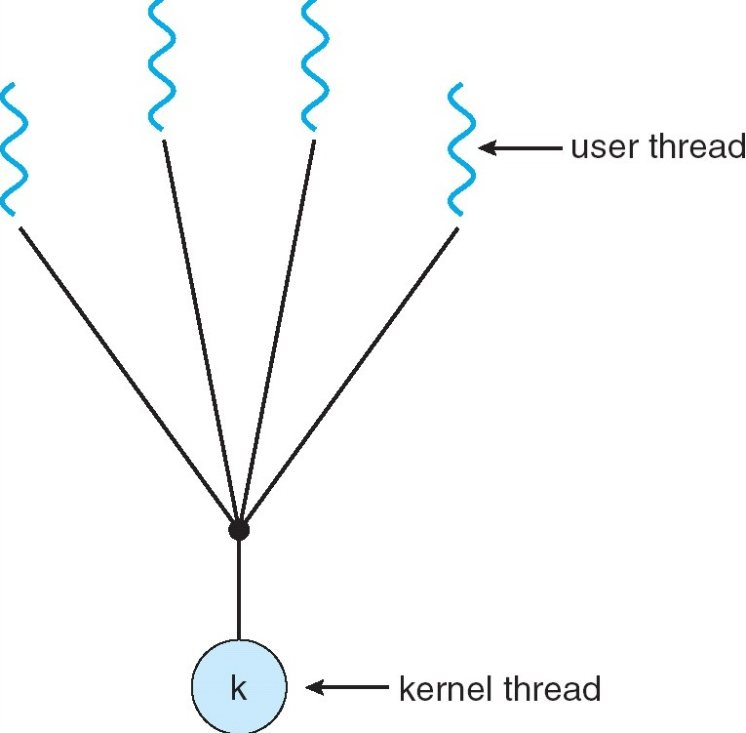
Many-to-One Model
Silberschatz, Galvin Operating System Concepts – 7th Edition and Gagne ©2005
Notes:
Thread management is done by the thread library in user space, so it is efficient.
However, the entire process will block if a thread makes a blocking system call.
Also, because only one thread can access the kernel at a time, multiple threads are unable to run in parallel on multicore systems.

Slide 16
One-to-One
Each user-level thread maps to kernel thread
Examples
Windows NT/XP/2000
Linux
Solaris 9 and later
Silberschatz, Galvin Operating System Concepts – 7th Edition and Gagne ©2005
Notes:
maps each user thread to a kernel thread
more concurrency than the many-to-one model by allowing another thread to run when a thread makes a blocking system call.
.It also allows multiple threads to run in parallel on multiprocessors.
The only drawback to this model is that creating a user thread requires creating the corresponding kernel thread.
the overhead of creating kernel threads can burden the performance of an application, most implementations of this model restrict the
number of threads supported by the system.

Slide 17
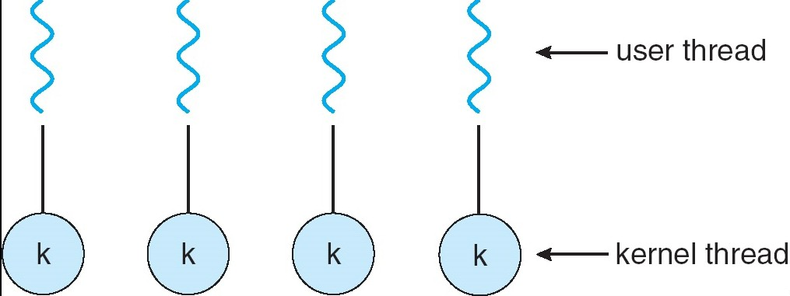
One-to-one Model
Silberschatz, Galvin Operating System Concepts – 7th Edition and Gagne ©2005

Slide 18
Many-to-Many Model
Allows many user level threads to be mapped to many kernel threads
Allows the operating system to create a sufficient number of kernel threads
Solaris prior to version 9
Windows NT/2000 with the ThreadFiber package
Silberschatz, Galvin Operating System Concepts – 7th Edition and Gagne ©2005
Notes:
The many-to-many model (Figure 4.7) multiplexes many user-level threads to a smaller or equal number of kernel threads.
The number of kernel threads may be specific to either a particular application or a particular machine

Slide 19
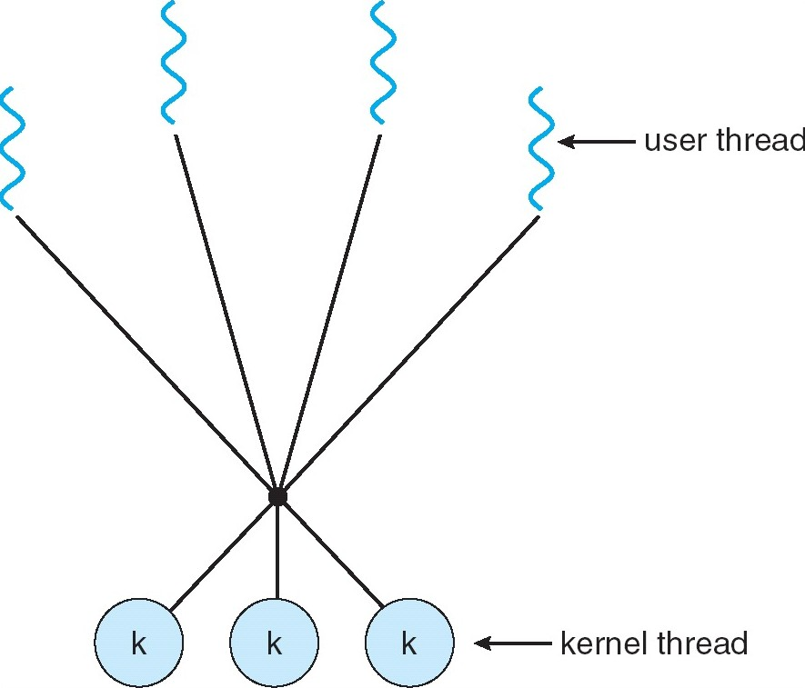
Many-to-Many Model
Silberschatz, Galvin Operating System Concepts – 7th Edition and Gagne ©2005
Notes:
The many-to-many model (Figure 4.7) multiplexes many user-level threads to a smaller or equal number of kernel threads.
The number of kernel threads may be specific to either a particular application or a particular machine

Slide 20
Two-level Model
Similar to M:M, except that it allows a user thread to be bound to kernel thread
Examples
IRIX
HP-UX
Tru64 UNIX
Solaris 8 and earlier
Silberschatz, Galvin Operating System Concepts – 7th Edition and Gagne ©2005

Slide 21
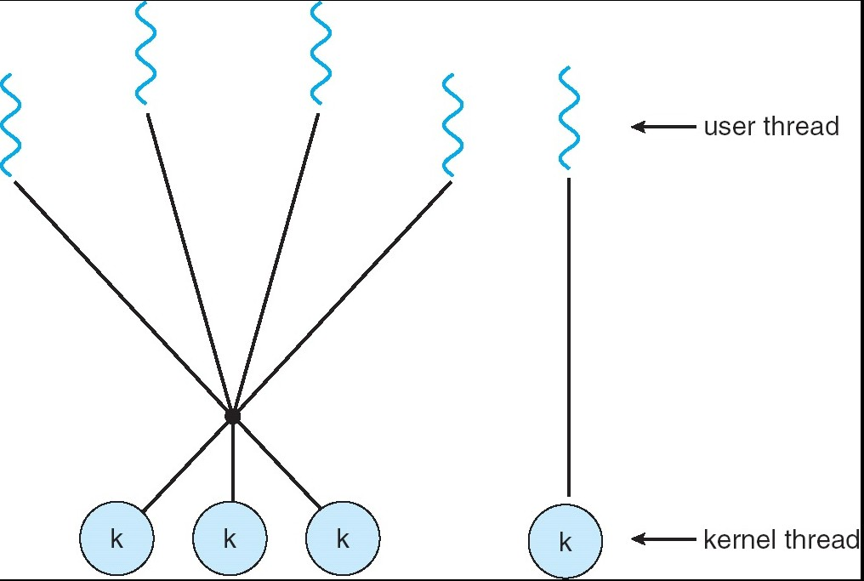
Two-level Model
Silberschatz, Galvin Operating System Concepts – 7th Edition and Gagne ©2005

Slide 22
Threading Issues
Semantics of fork() and exec() system calls
Thread cancellation
Signal handling
Thread pools
Thread-specific data
Scheduler activations
Silberschatz, Galvin Operating System Concepts – 7th Edition and Gagne ©2005

Slide 23
Semantics of fork() and exec()
Does fork() duplicate only the calling thread or all threads?
Some unix systems have two versions of fork(), one that duplicates all threads and another that duplicates the thread that invokes fork().
Exec() will replace the entire process.
Silberschatz, Galvin Operating System Concepts – 7th Edition and Gagne ©2005

Slide 24
Thread Cancellation
Terminating a thread before it has finished
Two general approaches:
Asynchronous cancellation terminates the target thread immediately
Deferred cancellation allows the target thread to periodically check via a flag if it should be cancelled
Silberschatz, Galvin Operating System Concepts – 7th Edition and Gagne ©2005

Slide 25
Signal Handling
Signals are used in UNIX systems to notify a process that a particular event has occurred
A signal handler is used to process signals
Signal is generated by particular event
Signal is delivered to a process
Signal is handled
Options: (method of delivery depends on the type of signal)
Deliver the signal to the thread to which the signal applies
Deliver the signal to every thread in the process
Deliver the signal to certain threads in the process
Assign a specific thread to receive all signals for the process
Silberschatz, Galvin Operating System Concepts – 7th Edition and Gagne ©2005

Slide 26
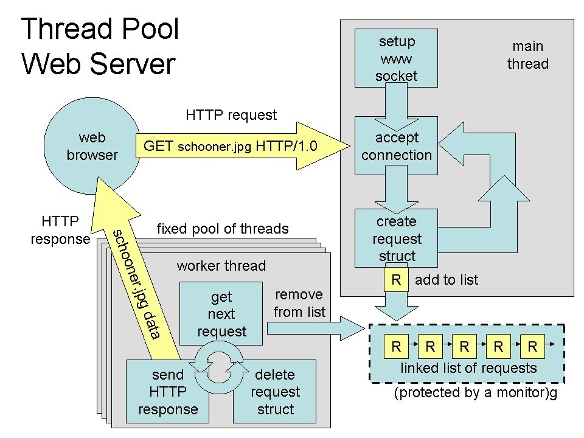
Thread Pools
Create a number of threads in a pool where they await work
Advantages:
Usually slightly faster to service a request with an existing thread than create a new thread
Allows the number of threads in the application(s) to be bound to the size of the pool
Silberschatz, Galvin Operating System Concepts – 7th Edition and Gagne ©2005
Notes:
Whenever the server receives a request, it creates a separate thread to service the request.
Whereas creating a separate thread is certainly superior to creating a separate process, a multithreaded server nonetheless has potential problems.
Problems:
1. the amount of time required to create the thread, together with the fact that the thread will be discarded once it has completed its work.
2. If we allow all concurrent requests to be serviced in a new thread, we have not placed a bound on the number of threads concurrently active
in the system.
The general idea behind a thread pool is to create a number of threads at process startup and place them into a pool, where they sit and wait for work.
When a server receives a request, it awakens a thread from this pool—if one is available—and passes it the request for service. Once the thread completes
its service, it returns to the pool and awaits more work. If the pool contains no available thread, the server waits until one becomes free.

Slide 27
Thread Specific Data
Allows each thread to have its own copy of data
Useful when you do not have control over the thread creation process (i.e., when using a thread pool)
Unlike processes, all threads in a single program share the same address space. This means that if one thread modifies a location in memory (for instance, a global variable), the change is visible to all other threads.
thread-specific data area: The variables stored in this area are duplicated for each thread, and each thread may modify its copy of a variable without affecting other threads.
Silberschatz, Galvin Operating System Concepts – 7th Edition and Gagne ©2005

Slide 28
Scheduler Activations
Both M:M and Two-level models require communication to maintain the appropriate number of kernel threads allocated to the application
LWP (Light-weight process) is a virtual processor attached to kernel thread
Scheduler activations provide upcalls - a communication mechanism from the kernel to the thread library
Upcalls are handled by the thread library with an upcall handler
This communication allows an application to maintain the correct number of kernel threads
when an application thread is about to block, an upcall is triggered.
Silberschatz, Galvin Operating System Concepts – 7th Edition and Gagne ©2005
Notes:
Many systems implementing either the many-to-many or the two-level
model place an intermediate data structure between the user and kernel
threads. This data structure—typically known as a lightweight process, or
LWP—is shown in Figure 4.13. To the user-thread library, the LWP appears to
be a virtual processor on which the application can schedule a user thread to
run.
One scheme for communication between the user-thread library and the
kernel is known as scheduler activation. It works as follows: The kernel
provides an application with a set of virtual processors (LWPs), and the
application can schedule user threads onto an available virtual processor.
Furthermore, the kernel must inform an application about certain events. This
procedure is known as an upcall.
Upcalls are handled by the thread library
with an upcall handler, and upcall handlers must run on a virtual processor.

Slide 29
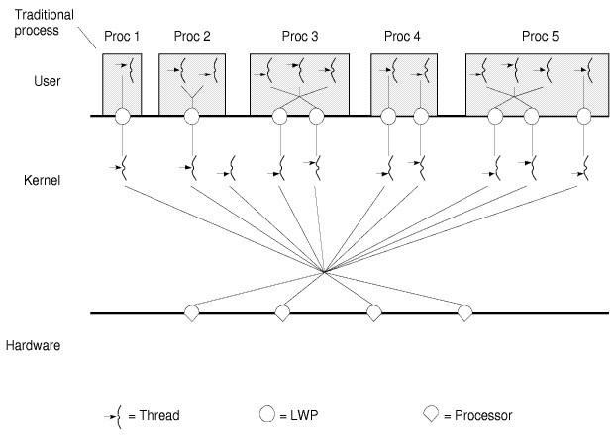
LWP : Light-weight Process
Silberschatz, Galvin Operating System Concepts – 7th Edition and Gagne ©2005

Slide 30
Pthreads
A POSIX standard (IEEE 1003.1c) API for thread creation and synchronization
API specifies behavior of the thread library, implementation is up to development of the library
Common in UNIX operating systems (Solaris, Linux, Mac OS X)
Q: Is it a use or Kernal-level Library?
Can be either user- or kernel- level.
Silberschatz, Galvin Operating System Concepts – 7th Edition and Gagne ©2005
Notes:
Pthreads refers to the POSIX standard (IEEE 1003.1c) defining an API for thread
creation and synchronization. This is a specification for thread behavior,
not an implementation. Operating-system designers may implement the
specification in any way they wish. Numerous systems implement the Pthreads
specification; most are UNIX-type systems, including Linux, Mac OS X, and
Solaris. Although Windows doesn’t support Pthreads natively, some thirdparty
implementations for Windows are available.

Slide 31
Windows XP Threads
Implements the one-to-one mapping
Each thread contains
A thread id
Register set
Separate user and kernel stacks
Private data storage area
The register set, stacks, and private storage area are known as the context of the threads
The primary data structures of a thread include:
ETHREAD (executive thread block)
KTHREAD (kernel thread block)
TEB (thread environment block)
Silberschatz, Galvin Operating System Concepts – 7th Edition and Gagne ©2005
Notes:
• ETHREAD—executive thread block
• KTHREAD—kernel thread block
• TEB—thread environment block
ETHREAD include a pointer to the process to which the thread belongs and the address of the routine in which the thread starts control.
KTHREAD includes scheduling and synchronization information for the thread.
TEB is a user-space data structure that is accessed when the thread is running in user mode.

Slide 32
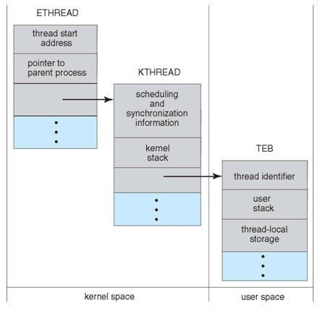
Structures of Thread
Silberschatz, Galvin Operating System Concepts – 7th Edition and Gagne ©2005

Slide 33
Linux Threads
Linux refers to them as tasks rather than threads
Thread creation is done through clone() system call
clone() allows a child task to share the address space of the parent task (process)
Silberschatz, Galvin Operating System Concepts – 7th Edition and Gagne ©2005

Slide 34
Java Threads
Java threads are managed by the JVM
Java threads may be created by:
Extending Thread class
Implementing the Runnable interface
Silberschatz, Galvin Operating System Concepts – 7th Edition and Gagne ©2005
Notes:
One approach is to create a new class that is derived from the Thread class and to override its run() method.
Thread creation is performed by creating an object instance of the Thread class and passing the constructor a Runnable object.

Slide 35
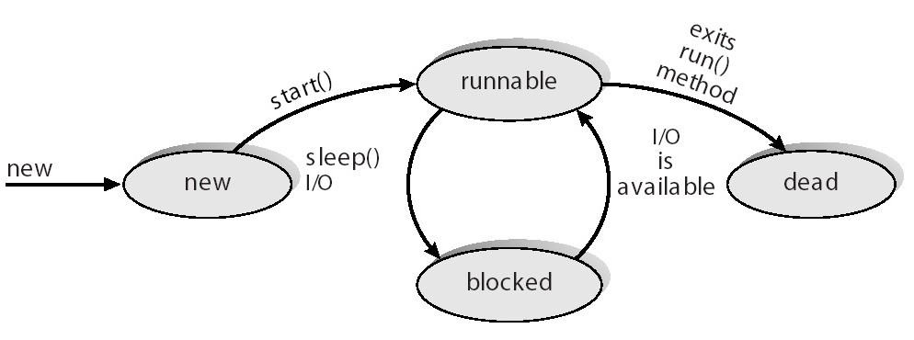
Java Thread States
Silberschatz, Galvin Operating System Concepts – 7th Edition and Gagne ©2005

Slide 36
Thank you

